Slide 1
Lecture Notes
Frequency, Stem-and-Leaf Graphs , Histograms
Prof. Xin, Ke
OER – www.helpyourmath.com

Slide 2
Frequency
A frequency is the number of times a value of the data occurs.
A relative frequency is the ratio (fraction or proportion) of the number of times a value of the data occurs in the set of all outcomes to the total number of outcomes.
Cumulative relative frequency is the accumulation of the previous relative frequencies.
Example: 5; 6; 3; 3; 2; 4; 7; 5; 2; 3; 5; 6; 5; 4; 4; 3; 5; 2; 5; 3.
Data value | Frequency | RELATIVE FREQUENCY | CUMULATIVE RELATIVE FREQUENCY
2 | 3 | 3/20=0.15 | 0.15
3 | 5 | 5/20=0.25 | 0.15+0.25=0.40
4 | 3 | 3/20=0.15 | 0.40+0.15=0.55
5 | 6 | 6/20=0.30 | 0.55+0.30=0.85
6 | 2 | 2/20=0.10 | 0.85+0.10=0.95
7 | 1 | 1/20=0.05 | 0.95+0.05=1.00

Slide 3
Stem-and-Leaf Graphs (Stemplots)
stem-and-leaf graph or stemplot, comes from the field of exploratory data analysis. It is a good choice when the data sets are small.
To create the plot, divide each observation of data into a stem and a leaf.
The leaf consists of a final significant digit.
Example:
33; 42; 49; 49; 53; 55; 55; 61; 63; 67; 68; 68; 69; 69; 72; 73; 74; 78; 80; 83; 88; 88; 88; 90; 92; 94; 94; 94; 94; 96; 100
Stem | Leaf
3 | 3
4 | 2 9 9
5 | 3 5 5
6 | 1 3 7 8 8 9 9
7 | 2 3 4 8
8 | 0 3 8 8 8
9 | 0 2 4 4 4 4 6
10 | 0

Slide 4
Histograms
A histogram consists of contiguous (adjoining) boxes.
It has both a horizontal axis and a vertical axis. The horizontal axis is labeled with what the data represents. The vertical axis is labeled either frequency or relative frequency.
To construct a histogram, first decide how many bars or intervals, also called classes, represent the data. Many histograms consist of five to 15 bars or classes for clarity. The number of bars needs to be chosen. Choose a starting point for the first interval to be less than the smallest data value.
A convenient starting point is a lower value carried out to one more decimal place than the value with the most decimal places. (For example, if the value with the most decimal places is 6.1 and this is the smallest value, a convenient starting point is 6.05(6.1–0.05=6.05).)

Slide 5
Histograms Example
The following data are the heights (in inches to the nearest half inch) of 100 male semiprofessional soccer players. The heights are continuous data, since height is measured. 60; 60; 61; 61; 61; 63; 63; 63; 64; 64; 64; 64; 64; 64; 64; 64; 64; 64; 64; 64; 64; 64; 64; 66; 66; 66; 66; 66; 66; 66; 66; 66; 66; 66; 66; 66; 66; 66; 66; 66; 66; 66; 66; 66; 67; 67; 67; 67; 67; 67; 67; 67; 67; 67; 67; 67; 67; 67; 67; 67; 67; 67; 67 68; 68; 69; 69; 69; 69; 69; 69; 69; 69; 69; 69; 69; 69; 69; 69; 69 70; 70; 70; 70; 70; 70; 70; 70; 70; 71; 71; 71 72; 72; 72; 72; 72; 73; 73; 74

Slide 6
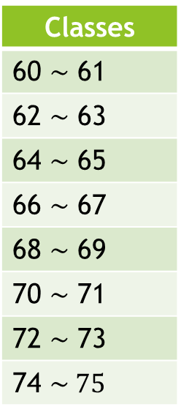
Width
Next, calculate the width of each bar or class interval. To calculate this width, subtract the starting point from the ending value and divide by the number of bars (you must choose the number of bars you desire).
width of a class = $\frac{highest value in data set −lowest value in data set }{desired number of class}$. However, we will choose an integer for width value. Therefore, we choose the number’s integer part and plus 1 as width. We get width of a class =[$\frac{highest value in data set −lowest value in data set }{desired number of class}$] + 1
In the example, the highest value in data set is 74, the lowest value in data set is 60. We can desire number of class is 8, so we can get:
Width of a class = $\frac{74−60}{8}$ = 1.75, $but we will choose the number^{′}s$ integer part and plus 1 as width. Therefore, width = $[1.75]$+1=2
Then, we can get the classes on the right side:
Classes
60 $\sim$ 61
62 $\sim$ 63
64 $\sim$ 65
66 $\sim$ 67
68 $\sim$ 69
70 $\sim$ 71
72 $\sim$ 73
74 $\sim 75$

Slide 7
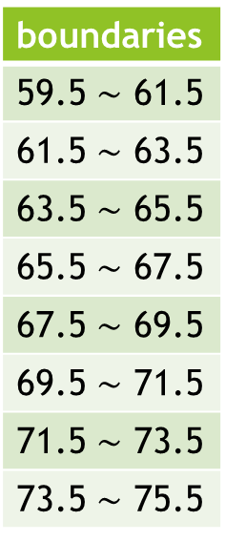
The class has class limits, and they are lower class limits(LCL) and upper class limits(UCL).
The class boundary also has lower class boundary(LCB) and upper class boundary(UCB).
The relationship between class and boundary: LCB=LCL - $\frac{D}{2}$ and UCB=UCL + $\frac{D}{2}$ (1) where D is the difference between the LCL of the next class interval and the UCL of the given class interval.
From above, we still can get: LCL=LCB + $\frac{D}{2}$ and UCL=UCB - $\frac{D}{2}$ (2)
In the example: D = LCL - LCB = $\frac{61−60}{2}$ = 0.5
Therefore, we can get the boundaries on the right side:
boundaries
59.5 $\sim$ 61.5
61.5 $\sim$ 63.5
63.5 $\sim$ 65.5
65.5 $\sim$ 67.5
67.5 $\sim$ 69.5
69.5 $\sim$ 71.5
71.5 $\sim$ 73.5
73.5 $\sim$ 75.5

Slide 8
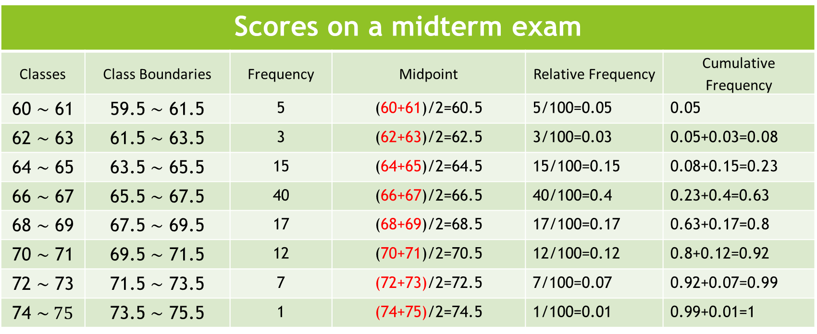
Table:
Scores on a midterm exam
Classes | Class Boundaries | Frequency | Midpoint | Relative Frequency | Cumulative Frequency
60 $\sim$ 61 | 59.5 $\sim$ 61.5 | 5 | (60+61)/2=60.5 | 5/100=0.05 | 0.05
62 $\sim$ 63 | 61.5 $\sim$ 63.5 | 3 | (62+63)/2=62.5 | 3/100=0.03 | 0.05+0.03=0.08
64 $\sim$ 65 | 63.5 $\sim$ 65.5 | 15 | (64+65)/2=64.5 | 15/100=0.15 | 0.08+0.15=0.23
66 $\sim$ 67 | 65.5 $\sim$ 67.5 | 40 | (66+67)/2=66.5 | 40/100=0.4 | 0.23+0.4=0.63
68 $\sim$ 69 | 67.5 $\sim$ 69.5 | 17 | (68+69)/2=68.5 | 17/100=0.17 | 0.63+0.17=0.8
70 $\sim$ 71 | 69.5 $\sim$ 71.5 | 12 | (70+71)/2=70.5 | 12/100=0.12 | 0.8+0.12=0.92
72 $\sim$ 73 | 71.5 $\sim$ 73.5 | 7 | (72+73)/2=72.5 | 7/100=0.07 | 0.92+0.07=0.99
74 $\sim 75$ | 73.5 $\sim$ 75.5 | 1 | (74+75)/2=74.5 | 1/100=0.01 | 0.99+0.01=1

Slide 9
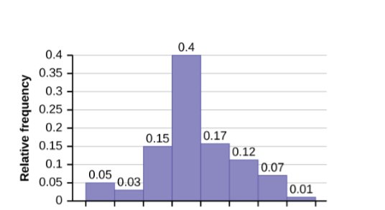
The following histogram displays the heights on the x-axis and relative frequency on the y-axis.
59.5
61.5
63.5
65.5
67.5
69.5
71.5
73.5
75.5
Heights

Slide 10
Practice 1
For data set below, create a histogram with 6 classes.
76,84,76,103,92, 47,98,54,80,91, 69,86,83,75,93 69,86,83,75,93 89,96,65,94,85
Solution Video

Slide 11
Practice 2
For data set below, create a histogram with 6 classes.
4.53,3.83,3.83,4.23,4.70, 1.83,4.00,2.00,3.57,4.25, 2.75,4.47,3.35,3.27,4.30, 4.25,4.05,2.12,4.63,4.18,
Solution Video

